Slide 1
Relational Database Design
Dr. S. RENUKA DEVI
Associate Profesor
SCSE
VIT Chennai Campus

Slide 2
Relational Model Concepts
Relational model represents the database as a collection of relations
Each row in the table represents a collection of related data values
Each relation resembles a table of values or, to some extent, a flat file of records
Row is called a tuple
Column header is called an attribute
Table is called a relation
Data type that can appear in each column is represented by a domain of possible values

Slide 3
Relational Model Concepts
Relation schema R is denoted by R(A1, A2, ...,An),
where R is the relation name and A1, A2, ..., An is a list of attributes
D is called the domain of Ai and is denoted by dom(Ai)
Degree (or arity) of a relation is the number of attributes n of its relation schema

Slide 4
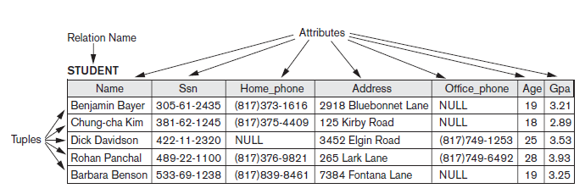
Attributes and Tuples of a Relation

Slide 5
Relational Model Constraints
Constraints - various restrictions on data that can be specified on a relational database
Constraints on databases can generally be divided into three main categories:
Inherent model-based constraints or implicit constraints - Constraints that are inherent in the data model
E.g., a relation cannot have duplicate tuples
Schema-based constraints or explicit constraints - Constraints that can be directly expressed in schemas of the data model, typically by specifying them in the DDL
Application-based or semantic constraints or business rules - Constraints that cannot be directly expressed in the schemas but expressed and enforced by the application programs
Another important category of constraints is data dependencies, which include functional dependencies and multivalued dependencies

Slide 6
Domain Constraints
Domain constraints specify that within each tuple, the value of each attribute A must be an atomic value from the domain dom(A)
The data types associated with domains typically include
integers (such as short integer, integer, and long integer)
real numbers (float and double precision float)
Characters
Booleans
fixed-length strings
variable-length strings
date, time, timestamp

Slide 7

Key Constraints and Constraints on NULL Values
All tuples in a relation must be distinct
There are other subsets of attributes of a relation schema R with the property that no two tuples in any relation state r of R should have the same combination of values for these attributes
Any such set of attributes SK is called a superkey of the relation schema R
Every relation has at least one default superkey—the set of all its attributes

Slide 8
Key Constraints and Constraints on NULL Values
A key K of a relation schema R is a superkey of R with the additional property that removing any attribute A from K leaves a set of attributes K that is not a superkey of R any more – minimal superkey
E.g., {Regno} is a key of STUDENT
{Regno, Name, Age}—is a superkey but not a key for STUDENT
A relation schema may have more than one key. In this case, each of the keys is called a candidate key
E.g., CAR relation has two candidate keys: License_number and Engine_serial_number
Another constraint on attributes specifies whether NULL values are or are not permitted
E.g., Name of STUDENT is constrained to be NOT NULL.

Slide 9
Relational Databases and Relational Database Schemas
A relational database schema S is a set of relation schemas S = {R1, R2, ..., Rm} and a set of integrity constraints IC
The underlined attributes represent primary keys

Slide 10
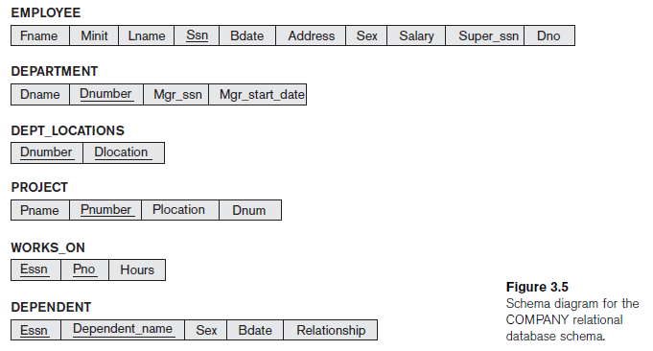

Slide 11
Integrity, Referential Integrity and Foreign Keys
Entity integrity constraint states that no primary key value can be NULL
Key constraints and entity integrity constraints are specified on individual relations
Referential integrity constraint is specified between two relations and is used to maintain the consistency among tuples in the two relations
We can diagrammatically display referential integrity constraints by drawing a directed arc from each foreign key to the relation it references

Slide 12
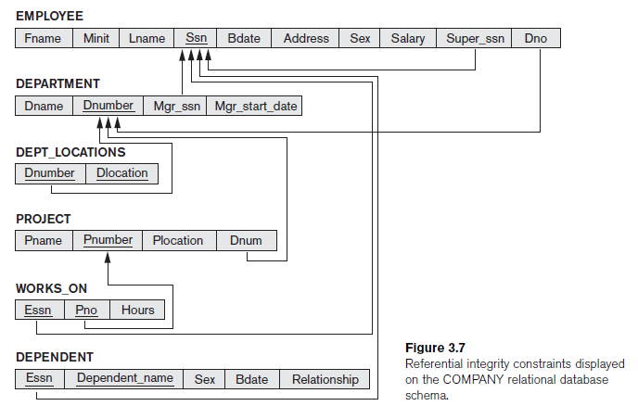

Slide 13
Constraint violation
There are three basic operations that can change the states of relations in the database: Insert, Delete, and Update (or Modify)
Whenever these operations are applied, the integrity constraints specified on the relational database schema should not be violated

Slide 14
Insert Operation
Insert can violate any of the four types of constraints
Domain constraints can be violated if an attribute value is given that does not appear in the corresponding domain or is not of the appropriate data type
Key constraints can be violated if a key value in the new tuple t already exists in another tuple in the relation r(R)
Entity integrity can be violated if any part of the primary key of the new tuple t is NULL
Referential integrity can be violated if the value of any foreign key in t refers to a tuple that does not exist in thereferenced relation

Slide 15
Delete Operation
The Delete operation can violate only referential integrity
This occurs if the tuple being deleted is referenced by foreign keys from other tuples in the database
Options that are available if a deletion operation causes a violation
Restrict – reject the deletion
Cascade - attempt to cascade (or propagate) the deletion by deleting tuples that reference the tuple that is being deleted
set null or set default - modify the referencing attribute values that cause the violation with NULL value or default value

Slide 16
Any Queries?

